Slide 1



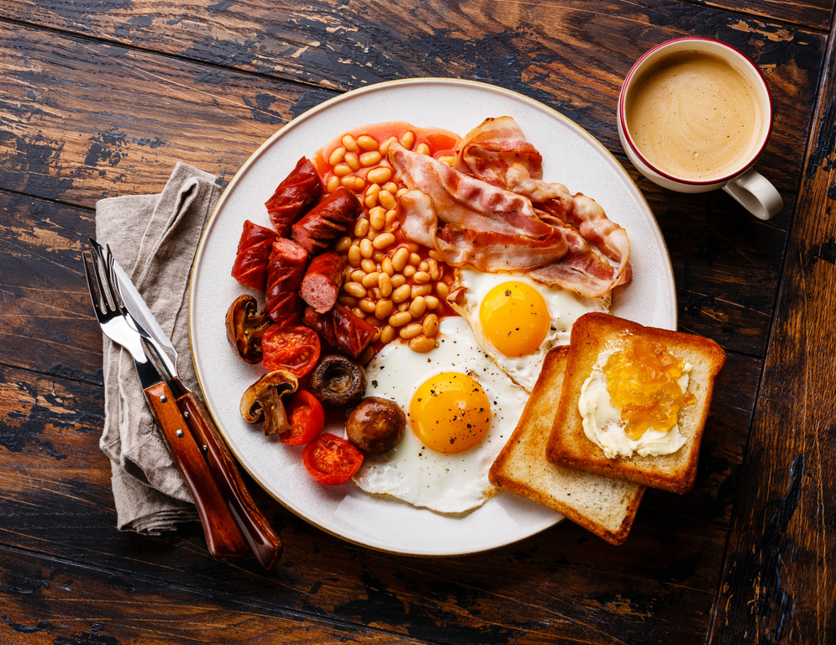


Self: Activities that work on the individual
CFO Evolution – May
Relationships: Activities that work with peers/families/friends
Monday 5th | Tuesday 6th | Wednesday 7th | Thursday 8th | Friday 9th
BANK HOLIDAY – HUB CLOSED | All Women’s Tuesday Wellbeing walk Benefit from physical activity in a walking group and Buying food on a budget 10am – 12pm | Baking morning Learn to bake on a budget (level 1 / level 2 food hygiene course) 10am – 1pm Wellbeing walk Benefit from physical activity in a walking group 12pm – 1.pm | Independent Living Cooking on a budget (level 1 / level 2 food hygiene course) 1pm – 3pm | Wellbeing walk Benefit from physical activity in a walking group and Buying food on a budget 10am – 12pm
 | All Women’s Tuesday Cooking on a budget (level 1 / level 2 food hygiene course) 1pm – 3pm | Arts and Crafts Develop your practical Skills 2pm – 4pm | Music and Dance Music Blox with Rich Songform Lyrics Garageband 1.30pm. | Wellbeing and mindfulness Do you struggle with mental health issues? Do you need support? Learn how to develop a Healthy & positive mental outlook.
Society: Activities contributing to the community outside of the CFO Activity Hub
Hull Activity Hub
*If you ever need a cuppa or a chat, pop in and speak to your support worker.
*Drop in Session available for
1-2-1 Support. Please contact your support worker.
Reception contact number: 07502299992
9:30am -4pm
Monday – Friday
CFO Activity Hub, 55 Savillle street, Norwich house, hull, HU1 3EA
This programme is delivered by HMPPS CFO

Slide 2
Self: Activities that work on the individual
CFO Evolution – May
Relationships: Activities that work with peers/families/friends
Monday 12th | Tuesday 13th | Wednesday 14th | Thursday 15th | Friday 16th
Life Skills Improve your IT skills to help navigate you through daily life and improve your communication and problem-solving skills to help find employment. 9.30am –1pm | All Women’s Tuesday Wellbeing walk Benefit from physical activity in a walking group and Buying food on a budget 10am – 12pm CBT Support your personal needs 10am – 4pm | Baking morning Learn to bake and decorate cakes 10am – 1pm (level 1 / level 2 food hygiene course) Wellbeing walk Benefit from physical activity in a walking group 12pm – 1.pm | EDI Black Inclusion Week Independent Living Cooking on a budget (level 1 / level 2 food hygiene course) 1pm – 3pm | EDI International Day Against Homophobia, Biphobia and Transphobia. Talk and Wellbeing Walk Benefit from physical activity in a walking group and Buying food on a budget 10am – 12pm
Start and introduction to Employability employment – (CV`s, disclosures, job search, national careers service) 1:30pm – 4pm | All Women’s Tuesday Cooking on a budget (level 1 / level 2 food hygiene course) 1pm – 3pm | Arts and Crafts Develop your practical Skills 2pm – 4pm | Music and Dance Music Blox with Rich Songform Lyrics Garageband 1.30pm | Wellbeing and mindfulness have a healthy and positive mental outlook & the importance of positive thoughts, feelings and behaviours in a session focused on men’s mental health
Society: Activities contributing to the community outside of the CFO Activity Hub
Hull Activity Hub
*If you ever need a cuppa or a chat, pop in and speak to your support worker.
*Drop in Session available for
1-2-1 Support. Please contact your support worker.
Reception contact number: 07502299992
9:30am -4pm
Monday – Friday
CFO Activity Hub, 55 Savillle street, Norwich house, hull, HU1 3EA
This programme is delivered by HMPPS CFO

Slide 3
Self: Activities that work on the individual
CFO Evolution – May
Relationships: Activities that work with peers/families/friends
Monday 19th | Tuesday 20th | Wednesday 21st | Thursday 22nd | Friday 23rd
Life Skills Improve your IT skills to help navigate you through daily life and improve your communication and problem-solving skills to help find employment. 9.30am –1pm | All Women’s Tuesday Wellbeing walk Benefit from physical activity in a walking group and Buying food on a budget 10am – 12pm | Baking morning Learn to bake and decorate cakes 10am – 1pm (level 1 / level 2 food hygiene course) Wellbeing walk Benefit from physical activity in a walking group 12pm – 1.pm | Independent Living Cooking on a budget (level 1 / level 2 food hygiene course) 1pm – 3pm | Wellbeing walk Benefit from physical activity in a walking group and Buying food on a budget 10am – 12pm
Start and introduction to Employability employment – (CV`s, disclosures, job search, national careers service) 1:30pm – 4pm | All Women’s Tuesday Cooking on a budget (level 1 / level 2 food hygiene course) 1pm – 3pm | Arts and Crafts Develop your practical Skills 2pm – 4pm | Music and Dance Music Blox with Rich Songform Lyrics Garageband 1.30pm | Wellbeing and mindfulness have a healthy and positive mental outlook & the importance of positive thoughts, feelings and behaviours in a session focused on men’s mental health
Society: Activities contributing to the community outside of the CFO Activity Hub
Hull Activity Hub
*If you ever need a cuppa or a chat, pop in and speak to your support worker.
*Drop in Session available for
1-2-1 Support. Please contact your support worker.
Reception contact number: 07502299992
9:30am -4pm
Monday – Friday
CFO Activity Hub, 55 Savillle street, Norwich house, hull, HU1 3EA
This programme is delivered by HMPPS CFO

Slide 4
Self: Activities that work on the individual
CFO Evolution – May
Relationships: Activities that work with peers/families/friends
Monday 26th | Tuesday 27th | Wednesday 28th | Thursday 29th | Friday 30th
BANK HOLIDAY – HUB CLOSED | All Women’s Tuesday Wellbeing walk Benefit from physical activity in a walking group and Buying food on a budget 10am – 12pm CBT Support your personal needs 10am – 4pm | Baking morning Learn to bake and decorate cakes 10am – 1pm (level 1 / level 2 food hygiene course) Wellbeing walk Benefit from physical activity in a walking group 12pm – 1.pm | Independent Living Cooking on a budget (level 1 / level 2 food hygiene course) 1pm – 3pm | Wellbeing walk Benefit from physical activity in a walking group and Buying food on a budget 10am – 12pm
 | All Women’s Tuesday Cooking on a budget (level 1 / level 2 food hygiene course) 1pm – 3pm | Arts and Crafts Develop your practical Skills 2pm – 4pm | Music and Dance Music Blox with Rich Songform Lyrics Garageband 1.30pm | Wellbeing and mindfulness have a healthy and positive mental outlook & the importance of positive thoughts, feelings and behaviours in a session focused on men’s mental health
Society: Activities contributing to the community outside of the CFO Activity Hub
Hull Activity Hub
*If you ever need a cuppa or a chat, pop in and speak to your support worker.
*Drop in Session available for
1-2-1 Support. Please contact your support worker.
Reception contact number: 07502299992
9:30am -4pm
Monday – Friday
CFO Activity Hub, 55 Savillle street, Norwich house, hull, HU1 3EA
This programme is delivered by HMPPS CFO

