Slide 1


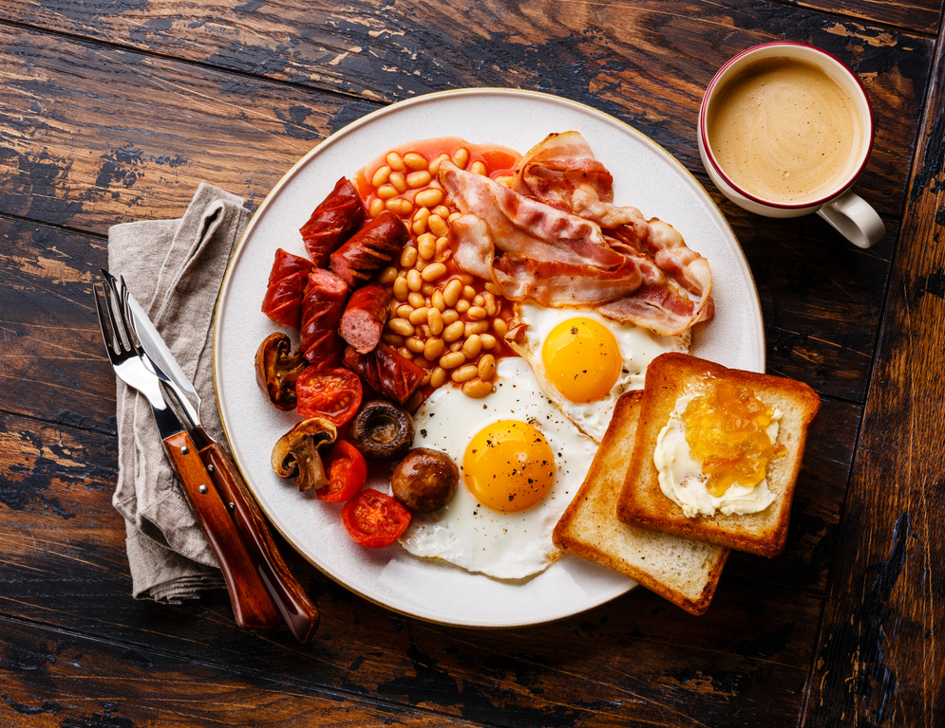









Self: Activities that work on the individual
CFO Evolution – August 2025
Relationships: Activities that work with peers/families/friends
Monday 4th | Tuesday 5th^{th} | Wednesday 6th | Thursday 7th | Friday 8th
Introduction to Basic Cooking skills 10am - 12.00pm | Enrolment Session and Meet the Team for Prison releases- Through the Gate inductions 10 – 13.00 | Manplan with Steve 10.00am – 12.00pm Men’s mental health group | Employability Researching chosen job profiles for suitability CV Support Email creation. Tailored CV’s - digital copy for job search Skills assessment – identify which skills needed for chosen job role. IT Literacy with Jenny Learn the basics and improve your IT Skills All day | Recipe for Success- 9.3am– 11.30pm Come in to the hub, cook breakfast, Networking around local jobs and agencies etc.
 | Personal development sessions Improving Communication/Time Management/ Building Confidence etc 1pm – 3pm
Baking 1.30pm – 3pm With Rachel |  | Arts and Crafts 1pm – 3pm |  | Quiz/Social games 13.00am-15.00pm
Society: Activities contributing to the community outside of the CFO Activity Hub
Doncaster CFO Activity Hub
Unit 25/27
7 Queens Crescent
Doncaster
DN1 3JN
If you ever need a cuppa or a chat, pop in and speak to your support worker.
Reception contact number: 07502299992
9:30am – 16:00pm
Monday – Friday
This programme is delivered by HMPPS CFO

Slide 2
Self: Activities that work on the individual
CFO Evolution – August 2025
Relationships: Activities that work with peers/families/friends
Monday 11th | Tuesday 12th | Wednesday 13th | Thursday 14th | Friday 15th
Introduction to Basic Cooking skills 9:30am - 10:30am Cooking on a budget 10:30am – 12pm With Rach | Enrolment Session and Meet the Team for Prison releases Through the Gate inductions 10 – 13.00 | Man plan with Steve 10.00 – 12.00 Men’s mental health support | Employability Researching chosen job profiles for suitability CV Support Email creation. Tailored CV’s - digital copy for job search Skills assessment – identify which skills needed for chosen job role. IT Literacy with Jenny Learn the basics and improve your IT Skills All day | Recipe for Success 9.30 – 11.30 Come into the hub, cook breakfast, Networking around local jobs and agencies etc.
 | Personal development sessions Improving Communication/ Time Management/ Building Confidence etc
Baking 1pm – 3pm With Rachel |  | Arts and Crafts 1pm – 3pm |  | Quiz/Social games 13.00-15.00
Society: Activities contributing to the community outside of the CFO Activity Hub
Doncaster CFO Activity Hub
Unit 25/27
7 Queens Crescent
Doncaster
DN1 3JN
If you ever need a cuppa or a chat, pop in and speak to your support worker.
Reception contact number: 07502299992
9:30am – 16:00pm
Monday – Friday
This programme is delivered by HMPPS CFO

Slide 3
Self: Activities that work on the individual
CFO Evolution – August 2025
Relationships: Activities that work with peers/families/friends
Monday 18th | Tuesday 19th | Wednesday 20th | Thursday 21st | Friday 22nd
Introduction to Basic Cooking skills 9:30am - 10:30am | Through the Gate Hub induction (support available for anyone being released from custody) CFO Evolution information session (meet the team and enrol!) 10am – 1pm | Manplan with Steve 10.00 – 12.00 Men’s mental health support | Employability Researching chosen job profiles for suitability CV Support Email creation. Tailored CV’s - digital copy for job search Skills assessment – identify which skills needed for chosen job role. IT Literacy with Jenny Learn the basics and improve your IT Skills All day! | Recipe for Success 9.30 – 11.30 Come into the hub, cook breakfast, Networking around local jobs and agencies etc.
 | Personal development sessions Improving Communication/ Time Management/ Building Confidence etc 1pm – 3pm
Baking with Rach 1pm – 3pm |  | Arts and Crafts 1pm – 3pm |  | Quiz/Social games 13.00-15.00
Society: Activities contributing to the community outside of the CFO Activity Hub
Doncaster CFO Activity Hub
Unit 25/27
7 Queens Crescent
Doncaster
DN1 3JN
If you ever need a cuppa or a chat, pop in and speak to your support worker.
Reception contact number: 07502299992
9:30am – 16:00pm
Monday – Friday
This programme is delivered by HMPPS CFO

Slide 4
Self: Activities that work on the individual
CFO Evolution – August 2025
Relationships: Activities that work with peers/families/friends
Monday 25th | Tuesday 26th | Wednesday 27th | Thursday 28th | Friday 29th
Bank Holiday Hub closed | Through the Gate Hub induction (support available for anyone being released from custody) CFO Evolution information session (meet the team and enrol!) 10am – 1pm | Manplan with Steve 10.00 – 12.00 Men’s mental health support | Employability Researching chosen job profiles for suitability CV Support Email creation. Tailored CV’s - digital copy for job search Skills assessment – identify which skills needed for chosen job role. IT Literacy with Jenny Learn the basics and improve your IT Skills All day! | Recipe for Success 9.30 – 11.30 Come into the hub, cook breakfast, Networking around local jobs and agencies etc.
 | Personal development sessions Improving Communication/ Time Management/ Building Confidence etc 1pm – 3pm
 |  | Arts and Crafts 1pm – 3pm |  | Quiz/Social games 13.00-15.00
Society: Activities contributing to the community outside of the CFO Activity Hub
Doncaster CFO Activity Hub
Unit 25/27
7 Queens Crescent
Doncaster
DN1 3JN
If you ever need a cuppa or a chat, pop in and speak to your support worker.
Reception contact number: 07502299992
9:30am – 16:00pm
Monday – Friday
This programme is delivered by HMPPS CFO

