Slide 1


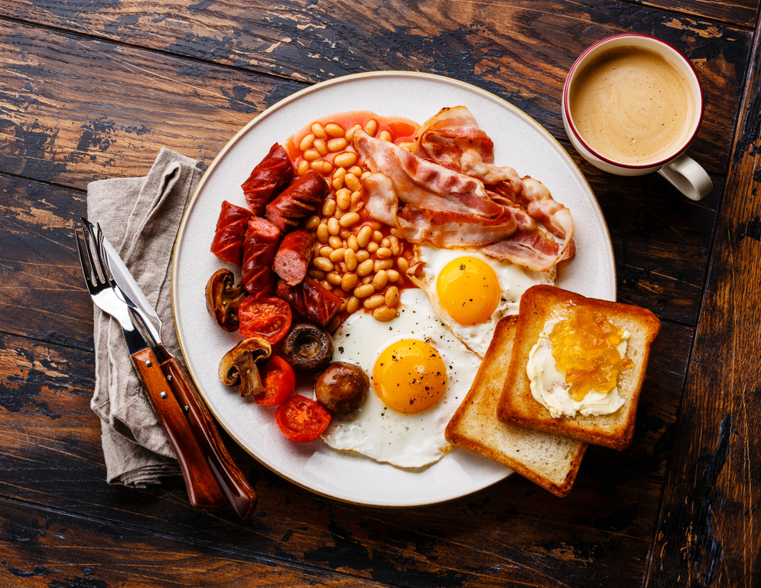









Self: Activities that work on the individual
CFO Evolution – November 2025
Relationships: Activities that work with peers/families/friends
Monday 3rd | Tuesday 4th | Wednesday 5th | Thursday 6th | Friday 7th
Hub open from 9:30 for drop-in support! | Hub open from 9:30 for drop-in support! | Hub open from 9:30 for drop-in support! | Hub open from 9:30 for drop-in support! | Hub open from 9:30 for drop-in support!
Cooking 10:30 – 12:30 | Employability drop-in sessions CV support/ Email creation./ Skills assessment / Job search profile 10am – 12pm Enrolment Session and Meet the Team for Prison releases Through the Gate inductions 10:00 – 13:00 | Baking 10:30 -12:30 Employability drop-in sessions CV support/ Email creation./ Skills assessment / Job search profile 10am – 12pm | Health, Wellbeing and Fitness with Liam Ravenhill! 10am – 12pm and 1pm – 3pm | Breakfast and Manplan with Steve 13:00 -15:00 Men’s mental health support
UPW Session 13:30 – 15:30 Housing Agencies/ GP/Dentist/ ID General Support 13:30 – 15:30 | Personal development sessions for improving communication/ Time Management/ Building Confidence 13:00 – 15:00 | IT Literacy with Jenny Learn the basics and improve your IT Skills Arts and Crafts 13:00 – 15:00 |  | Quiz/Social games 13.00-15.00
Hub open 3pm – 4pm for drop in support | Hub open 3pm – 4pm for drop in support | Hub open 3pm – 4pm for drop in support | Hub open 3pm – 4pm for drop in support | Hub open 3pm – 4pm for drop in support
Society: Activities contributing to the community outside of the CFO Activity Hub
Doncaster CFO Activity Hub
Unit 25/27
7 Queens Crescent
Doncaster
DN1 3JN
If you ever need a cuppa or a chat, pop in and speak to your support worker.
Reception contact number: 07502299992
9:30am – 16:00pm
Monday – Friday
This programme is delivered by HMPPS CFO

Slide 2
Self: Activities that work on the individual
CFO Evolution – November 2025
Relationships: Activities that work with peers/families/friends
Monday 10th | Tuesday 11th | Wednesday 12th | Thursday 13th | Friday 14th
Hub open from 9:30 for drop-in support! | Hub open from 9:30 for drop-in support! | Hub open from 9:30 for drop-in support! | Hub open from 9:30 for drop-in support! | Hub open from 9:30 for drop-in support!
CBT Sessions 10:00 – 14:00 Cooking 10:30 – 12:30 | Employability drop-in sessions CV support/ Email creation./ Skills assessment / Job search profile 10am – 12pm Enrolment Session and Meet the Team for Prison releases Through the Gate inductions 10:00 – 13:00 CBT Sessions 10:00 -14:00 | Baking 10:30 -12:30 Employability drop-in sessions CV support/ Email creation./ Skills assessment / Job search profile 10am – 12pm | Health, Wellbeing and Fitness with Liam Ravenhill! 10am – 12pm and 1pm – 3pm | Breakfast and Manplan with Steve 13:00 -15:00 Men’s mental health support
 |  |  |  | Quiz/Social games 13.00-15.00
UPW Session 13:30 – 15:30 Housing Agencies/ GP/Dentist/ ID General Support 13:30 – 15:30 | Personal development sessions for improving communication/ Time Management/ Building Confidence 13:00 – 15:00 | IT Literacy with Jenny Learn the basics and improve your IT Skills Arts and Crafts 13:00 – 15:00
Hub open 3pm – 4pm for drop in support | Hub open 3pm – 4pm for drop in support | Hub open 3pm – 4pm for drop in support | Hub open 3pm – 4pm for drop in support | Hub open 3pm – 4pm for drop in support
Society: Activities contributing to the community outside of the CFO Activity Hub
Doncaster CFO Activity Hub
Unit 25/27
7 Queens Crescent
Doncaster
DN1 3JN
If you ever need a cuppa or a chat, pop in and speak to your support worker.
Reception contact number: 07502299992
9:30am – 16:00pm
Monday – Friday
This programme is delivered by HMPPS CFO

Slide 3
Self: Activities that work on the individual
CFO Evolution – November 2025
Relationships: Activities that work with peers/families/friends
Monday 17th | Tuesday 18th | Wednesday 19th | Thursday 20th | Friday 21st
Hub open from 9:30 for drop-in support! | Hub open from 9:30 for drop-in support! | Hub open from 9:30 for drop-in support! | Hub open from 9:30 for drop-in support! | Hub open from 9:30 for drop-in support!
Cooking 10:30 – 12:30 | Employability drop-in sessions CV support/ Email creation./ Skills assessment / Job search profile 10am – 12pm Enrolment Session and Meet the Team for Prison releases Through the Gate inductions 10:00 – 13:00 | Baking 10:30 -12:30 Employability drop-in sessions CV support/ Email creation./ Skills assessment / Job search profile 10am – 12pm | Health, Wellbeing and Fitness with Liam Ravenhill! 10am – 12pm and 1pm – 3pm | Breakfast and Manplan with Steve 13:00 -15:00 Men’s mental health support
 |  |  |  | Quiz/Social games 13.00-15.00
UPW Session 13:30 – 15:30 Housing Agencies/ GP/Dentist/ ID General Support 13:30 – 15:30 | Personal development sessions for improving communication/ Time Management/ Building Confidence 13:00 – 15:00 | IT Literacy with Jenny Learn the basics and improve your IT Skills Arts and Crafts 13:00 – 15:00
Hub open 3pm – 4pm for drop in support | Hub open 3pm – 4pm for drop in support | Hub open 3pm – 4pm for drop in support | Hub open 3pm – 4pm for drop in support | Hub open 3pm – 4pm for drop in support
Society: Activities contributing to the community outside of the CFO Activity Hub
Doncaster CFO Activity Hub
Unit 25/27
7 Queens Crescent
Doncaster
DN1 3JN
If you ever need a cuppa or a chat, pop in and speak to your support worker.
Reception contact number: 07502299992
9:30am – 16:00pm
Monday – Friday
This programme is delivered by HMPPS CFO

Slide 4
Self: Activities that work on the individual
CFO Evolution – November 2025
Relationships: Activities that work with peers/families/friends
Monday 24th | Tuesday 25th | Wednesday 26th | Thursday 27th | Friday 28th
Hub open from 9:30 for drop-in support! | Hub open from 9:30 for drop-in support! | Hub open from 9:30 for drop-in support! | Hub open from 9:30 for drop-in support! | Hub open from 9:30 for drop-in support!
CBT Sessions 10:00 – 14:00 Cooking 10:30 – 12:30 | Employability drop-in sessions CV support/ Email creation./ Skills assessment / Job search profile 10am – 12pm Enrolment Session and Meet the Team for Prison releases Through the Gate inductions 10:00 – 13:00 | Baking 10:30 -12:30 Employability drop-in sessions CV support/ Email creation./ Skills assessment / Job search profile 10am – 12pm | Health, Wellbeing and Fitness with Liam Ravenhill! 10am – 12pm and 1pm – 3pm | Breakfast and Manplan with Steve 13:00 -15:00 Men’s mental health support
 |  |  |  | Quiz/Social games 13.00-15.00
UPW Session 13:30 – 15:30 Housing Agencies/ GP/Dentist/ ID General Support 13:30 – 15:30 | Personal development sessions for improving communication/ Time Management/ Building Confidence 13:00 – 15:00 | IT Literacy with Jenny Learn the basics and improve your IT Skills Arts and Crafts 13:00 – 15:00
Hub open 3pm – 4pm for drop in support | Hub open 3pm – 4pm for drop in support | Hub open 3pm – 4pm for drop in support | Hub open 3pm – 4pm for drop in support | Hub open 3pm – 4pm for drop in support
Society: Activities contributing to the community outside of the CFO Activity Hub
Doncaster CFO Activity Hub
Unit 25/27
7 Queens Crescent
Doncaster
DN1 3JN
If you ever need a cuppa or a chat, pop in and speak to your support worker.
Reception contact number: 07502299992
9:30am – 16:00pm
Monday – Friday
This programme is delivered by HMPPS CFO

