Slide 1
Self: Activities that work on the individual
CFO Evolution – January 2025
Relationships: Activities that work with peers/families/friends
 |  | Wednesday 1st (Hub closed) | Thursday 2nd | Friday 3rd
We wish you a Happy New Year! Please note the CFO Doncaster Activity Hub reopens on the 2nd of January 2025. For any support over the Christmas period, please see below contact numbers: Samaritans 116 123 CALM 0800 58 58 58 MoneyHelper 0800 138 7777 National Domestic Abuse Helpline 0808 2000 247 NHS 111 Emergency helpline 999 |  |  | Mindful Movers (Wellbeing Walk) 10:00-12:00 With Mark | Mindfulness with Megan! 10am – 12pm
 |  |  | Mission Nutrition – Health eating for your wellbeing 13:00-14:00 Head in the Game – Mental health with social games 14:30-15:30 With Mark | Attitudes and Lifestyles (budgeting, accommodation and goal setting) 11am – 12pm
Society: Activities contributing to the community outside of the CFO Activity Hub
Doncaster Activity Hub
Unit 25/27 7 Queens Crescent Doncaster DN1 3JN
If you ever need a cuppa or a chat, pop in and speak to your support worker.
Reception contact number: 07502299992
9:30am – 16:00pm
Monday – Friday
This programme is delivered by HMPPS CFO

Slide 2
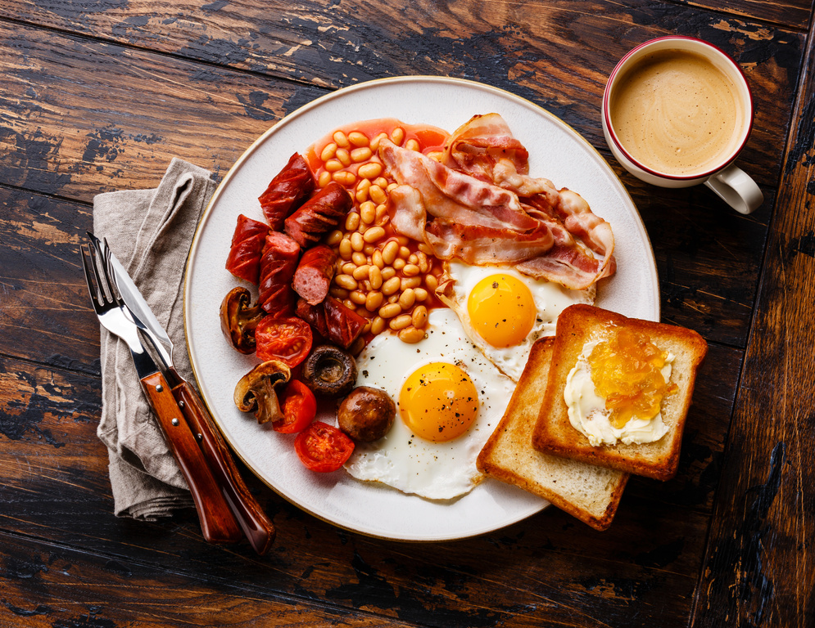
Self: Activities that work on the individual
CFO Evolution – January 2025
Relationships: Activities that work with peers/families/friends
Society: Activities contributing to the community outside of the CFO Activity Hub
Monday 6th | Tuesday 7th | Wednesday 8th | Thursday 9th | Friday 10th
Cooking on a budget 10am – 12pm With Katie | All day Employability with Pam Researching chosen job profiles for suitability Skills assessment – identify which skills needed for chosen job role. Upskilling for job roles chosen. Email creation. Tailored CV’s - digital copy for job search Cover Letters – how to create effective cover letter. Careers NCS website Interview techniques | Employability with Steve 10am – 12pm | Mindful Movers (Wellbeing Walk) 10:00-12:00 With Mark | Mindfulness with Megan! 10am – 12pm
 |  | Arts and Crafts 1pm – 3pm
Healthy Relationships 1pm – 3pm With Katie
 |  |  | Mission Nutrition – Health eating for your wellbeing 13:00-14:00 Head in the Game – Mental health with social games 14:30-15:30 With Mark | Attitudes and Lifestyles (budgeting, accommodation and goal setting) 11am – 12pm With Megan
 |  | Poetry with Steve 2pm – 3pm
Doncaster Activity Hub
Unit 25/27 7 Queens Crescent Doncaster DN1 3JN
If you ever need a cuppa or a chat, pop in and speak to your support worker.
Reception contact number: 07502299992
9:30am – 16:00pm
Monday – Friday
This programme is delivered by HMPPS CFO

Slide 3
Self: Activities that work on the individual
CFO Evolution – January 2025
Relationships: Activities that work with peers/families/friends
Society: Activities contributing to the community outside of the CFO Activity Hub
Monday 13th | Tuesday 14th | Wednesday 15th | Thursday 16th | Friday 17th
Cooking on a budget 10am – 12pm With Katie | All day Employability with Pam Researching chosen job profiles for suitability Skills assessment – identify which skills needed for chosen job role. Upskilling for job roles chosen. Email creation. Tailored CV’s - digital copy for job search Cover Letters – how to create effective cover letter. Careers NCS website Interview techniques | Employability with Steve 10am – 12pm | Mindful Movers (Wellbeing Walk) 10:00-12:00 With Mark | Mindfulness with Megan! 10am – 12pm
 |  | Arts and Crafts 1pm – 3pm
Healthy Relationships 1pm – 3pm With Katie
 |  |  | Mission Nutrition – Health eating for your wellbeing 13:00-14:00 Head in the Game – Mental health with social games 14:30-15:30 With Mark | Attitudes and Lifestyles (budgeting, accommodation and goal setting) 11am – 12pm With Megan
 |  | Poetry with Steve 2pm – 3pm
Doncaster Activity Hub
Unit 25/27 7 Queens Crescent Doncaster DN1 3JN
If you ever need a cuppa or a chat, pop in and speak to your support worker.
Reception contact number: 07502299992
9:30am – 16:00pm
Monday – Friday
This programme is delivered by HMPPS CFO

Slide 4
Self: Activities that work on the individual
CFO Evolution – January 2025
Relationships: Activities that work with peers/families/friends
Society: Activities contributing to the community outside of the CFO Activity Hub
Monday 20th | Tuesday 21st | Wednesday 22nd | Thursday 23rd | Friday 24th
Cooking on a budget 10am – 12pm With Katie | All day Employability with Pam Researching chosen job profiles for suitability Skills assessment – identify which skills needed for chosen job role. Upskilling for job roles chosen. Email creation. Tailored CV’s - digital copy for job search Cover Letters – how to create effective cover letter. Careers NCS website Interview techniques | Employability with Steve 10am – 12pm | Mindful Movers (Wellbeing Walk) 10:00-12:00 With Mark | Mindfulness with Megan! 10am – 12pm
 |  | Arts and Crafts 1pm – 3pm
Healthy Relationships 1pm – 3pm With Katie
 |  |  | Mission Nutrition – Health eating for your wellbeing 13:00-14:00 Head in the Game – Mental health with social games 14:30-15:30 With Mark | Attitudes and Lifestyles (budgeting, accommodation and goal setting) 11am – 12pm With Megan
 |  | Poetry with Steve 2pm – 3pm
Doncaster Activity Hub
Unit 25/27 7 Queens Crescent Doncaster DN1 3JN
If you ever need a cuppa or a chat, pop in and speak to your support worker.
Reception contact number: 07502299992
9:30am – 16:00pm
Monday – Friday
This programme is delivered by HMPPS CFO

Slide 5
Self: Activities that work on the individual
CFO Evolution – January 2025
Relationships: Activities that work with peers/families/friends
Society: Activities contributing to the community outside of the CFO Activity Hub
Monday 27th | Tuesday 28th | Wednesday 29th | Thursday 30th | Friday 31st
Cooking on a budget 10am – 12pm With Katie | All day Employability with Pam Researching chosen job profiles for suitability Skills assessment – identify which skills needed for chosen job role. Upskilling for job roles chosen. Email creation. Tailored CV’s - digital copy for job search Cover Letters – how to create effective cover letter. Careers NCS website Interview techniques | Employability with Steve 10am – 12pm | Mindful Movers (Wellbeing Walk) 10:00-12:00 With Mark | Mindfulness with Megan! 10am – 12pm
 |  | Arts and Crafts 1pm – 3pm
Healthy Relationships 1pm – 3pm With Katie
 |  |  | Mission Nutrition – Health eating for your wellbeing 13:00-14:00 Head in the Game – Mental health with social games 14:30-15:30 With Mark | Attitudes and Lifestyles (budgeting, accommodation and goal setting) 11am – 12pm With Megan
 |  | Poetry with Steve 2pm – 3pm
Doncaster Activity Hub
Unit 25/27 7 Queens Crescent Doncaster DN1 3JN
If you ever need a cuppa or a chat, pop in and speak to your support worker.
Reception contact number: 07502299992
9:30am – 16:00pm
Monday – Friday
This programme is delivered by HMPPS CFO

