Slide 1



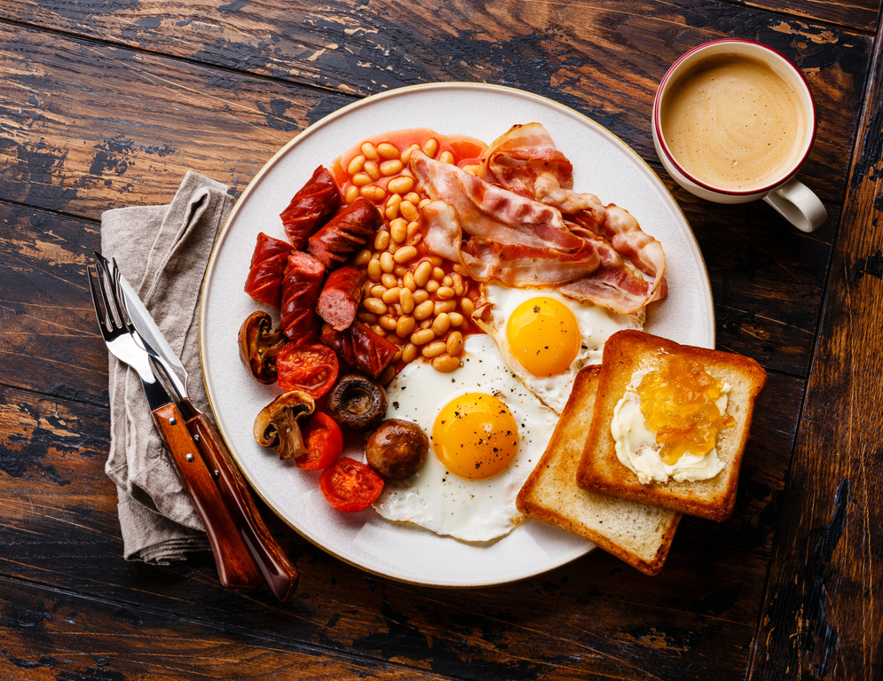








Self: Activities that work on the individual
CFO Evolution – October 2025
Relationships: Activities that work with peers/families/friends
Monday 29th | Tuesday 30th | Wednesday 1st Oct | Thursday 2nd Oct | Friday 3rd Oct
CBT Sessions 10:00 – 14:00 Cooking 10:30 – 12:30 | CBT Sessions 10:00 -14:00 Enrolment Session and Meet the Team for Prison releases Through the Gate inductions 10:00 – 13:00 | Health, Wellbeing and Fitness with Liam Ravenhill! 10am – 12pm and 1pm – 3pm | Baking 10:30 -12:30 Employability drop-in sessions CV support/ Email creation./ Skills assessment / Job search profile 10am – 2pm | Breakfast and Manplan with Steve 13:00 -15:00 Men’s mental health support
UPW Session 13:30 – 15:30 Housing Agencies/ GP/Dentist/ ID General Support 13:30 – 15:30 | Personal development sessions for improving communication/ Time Management/ Building Confidence 13:00 – 15:00 | Employability drop-in sessions CV support/ Email creation./ Skills assessment / Job search profile 1pm – 3pm Arts and Crafts 13:00 – 15:00 | IT Literacy with Jenny Learn the basics and improve your IT Skills | Quiz/Social games 13.00-15.00
Society: Activities contributing to the community outside of the CFO Activity Hub
Doncaster CFO Activity Hub
Unit 25/27
7 Queens Crescent
Doncaster
DN1 3JN
If you ever need a cuppa or a chat, pop in and speak to your support worker.
Reception contact number: 07502299992
9:30am – 16:00pm
Monday – Friday
This programme is delivered by HMPPS CFO

Slide 2
Self: Activities that work on the individual
CFO Evolution – October 2025
Relationships: Activities that work with peers/families/friends
Monday 6th | Tuesday 7th | Wednesday 8th | Thursday 9th | Friday 10th
Cooking 10:30 – 12:30 | Employability drop-in sessions CV support/ Email creation./ Skills assessment / Job search profile 10am – 12pm Enrolment Session and Meet the Team for Prison releases Through the Gate inductions 10:00 – 13:00 | Baking 10:30 -12:30 Employability drop-in sessions CV support/ Email creation./ Skills assessment / Job search profile | Health, Wellbeing and Fitness with Liam Ravenhill! 10am – 12pm and 1pm – 3pm | Breakfast and Manplan with Steve 13:00 -15:00 Men’s mental health support
UPW Session 13:30 – 15:30 Housing Agencies/ GP/Dentist/ ID General Support 13:30 – 15:30 | Personal development sessions for improving communication/ Time Management/ Building Confidence 13:00 – 15:00 | IT Literacy with Jenny Learn the basics and improve your IT Skills Arts and Crafts 13:00 – 15:00 |  | Quiz/Social games 13.00-15.00
Society: Activities contributing to the community outside of the CFO Activity Hub
Doncaster CFO Activity Hub
Unit 25/27
7 Queens Crescent
Doncaster
DN1 3JN
If you ever need a cuppa or a chat, pop in and speak to your support worker.
Reception contact number: 07502299992
9:30am – 16:00pm
Monday – Friday
This programme is delivered by HMPPS CFO

Slide 3
Self: Activities that work on the individual
CFO Evolution – October 2025
Relationships: Activities that work with peers/families/friends
Monday 13th | Tuesday 14th | Wednesday 15th | Thursday 16th | Friday 17th
CBT Sessions 10:00 – 14:00 Cooking 10:30 – 12:30 | Employability drop-in sessions CV support/ Email creation./ Skills assessment / Job search profile 10am – 12pm Enrolment Session and Meet the Team for Prison releases Through the Gate inductions 10:00 – 13:00 CBT Sessions 10:00 -14:00 | Baking 10:30 -12:30 Employability drop-in sessions CV support/ Email creation./ Skills assessment / Job search profile | Health, Wellbeing and Fitness with Liam Ravenhill! 10am – 12pm and 1pm – 3pm | Breakfast and Manplan with Steve 13:00 -15:00 Men’s mental health support
UPW Session 13:30 – 15:30 Housing Agencies/ GP/Dentist/ ID General Support 13:30 – 15:30 | Personal development sessions for improving communication/ Time Management/ Building Confidence 13:00 – 15:00 | IT Literacy with Jenny Learn the basics and improve your IT Skills Arts and Crafts 13:00 – 15:00 |  | Quiz/Social games 13.00-15.00
Society: Activities contributing to the community outside of the CFO Activity Hub
Doncaster CFO Activity Hub
Unit 25/27
7 Queens Crescent
Doncaster
DN1 3JN
If you ever need a cuppa or a chat, pop in and speak to your support worker.
Reception contact number: 07502299992
9:30am – 16:00pm
Monday – Friday
This programme is delivered by HMPPS CFO

Slide 4
Self: Activities that work on the individual
CFO Evolution – October 2025
Relationships: Activities that work with peers/families/friends
Monday 20th | Tuesday 21st | Wednesday 22nd | Thursday 23rd | Friday 24th
Cooking 10:30 – 12:30 | Employability drop-in sessions CV support/ Email creation./ Skills assessment / Job search profile 10am – 12pm Enrolment Session and Meet the Team for Prison releases Through the Gate inductions 10:00 – 13:00 | Baking 10:30 -12:30 Employability drop-in sessions CV support/ Email creation./ Skills assessment / Job search profile | Health, Wellbeing and Fitness with Liam Ravenhill! 10am – 12pm and 1pm – 3pm | Breakfast and Manplan with Steve 13:00 -15:00 Men’s mental health support
UPW Session 13:30 – 15:30 Housing Agencies/ GP/Dentist/ ID General Support 13:30 – 15:30 | Personal development sessions for improving communication/ Time Management/ Building Confidence 13:00 – 15:00 | IT Literacy with Jenny Learn the basics and improve your IT Skills Arts and Crafts 13:00 – 15:00 |  | Quiz/Social games 13.00-15.00
Society: Activities contributing to the community outside of the CFO Activity Hub
Doncaster CFO Activity Hub
Unit 25/27
7 Queens Crescent
Doncaster
DN1 3JN
If you ever need a cuppa or a chat, pop in and speak to your support worker.
Reception contact number: 07502299992
9:30am – 16:00pm
Monday – Friday
This programme is delivered by HMPPS CFO

Slide 5
Self: Activities that work on the individual
CFO Evolution – October 2025
Relationships: Activities that work with peers/families/friends
Monday 27th | Tuesday 28th | Wednesday 29th | Thursday 30th | Friday 31st
CBT Sessions 10:00 – 14:00 Cooking 10:30 – 12:30 | Employability drop-in sessions CV support/ Email creation./ Skills assessment / Job search profile 10am – 12pm Enrolment Session and Meet the Team for Prison releases Through the Gate inductions 10:00 – 13:00 CBT Sessions 10:00 -14:00 | Baking 10:30 -12:30 Employability drop-in sessions CV support/ Email creation./ Skills assessment / Job search profile | Health, Wellbeing and Fitness with Liam Ravenhill! 10am – 12pm and 1pm – 3pm | Breakfast and Manplan with Steve 13:00 -15:00 Men’s mental health support
UPW Session 13:30 – 15:30 Housing Agencies/ GP/Dentist/ ID General Support 13:30 – 15:30 | Personal development sessions for improving communication/ Time Management/ Building Confidence 13:00 – 15:00 | IT Literacy with Jenny Learn the basics and improve your IT Skills Arts and Crafts 13:00 – 15:00 |  | Quiz/Social games 13.00-15.00
Society: Activities contributing to the community outside of the CFO Activity Hub
Doncaster CFO Activity Hub
Unit 25/27
7 Queens Crescent
Doncaster
DN1 3JN
If you ever need a cuppa or a chat, pop in and speak to your support worker.
Reception contact number: 07502299992
9:30am – 16:00pm
Monday – Friday
This programme is delivered by HMPPS CFO

