Slide 1


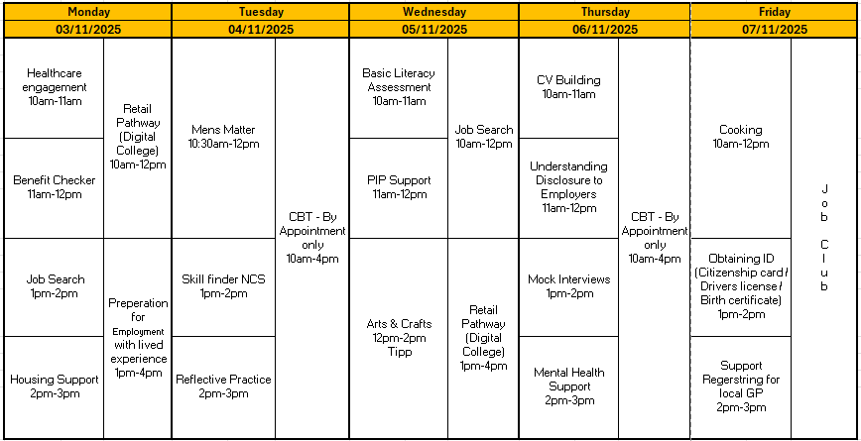



















Self: Activities that work on the individual
NOVEMBER - WEEK 1
Relationships: Activities that work with peers/families/friends
Society: Activities contributing to the community outside of the CFO Activity Hub
WEEK 2: CSCS GREEN CARD COURSE 9AM-3PM
Information
Address: - Urban Exchange, Theatre Street/Mount Street, Preston, PR1 8BQ
Contact: 07850 955413 (Amy)
Enrolments are needed to do any of the activities.
Our group activities include this week include; Men’s Matter, Arts & Crafts, Mock Interviews, Cooking and Job Club.
All other Activities will be 1:1 with support worker.
November is Men's Health Awareness Month: Men’s Matter sessions will Focus on raising awareness for men’s physical and mental health issues.
Wednesday 5TH Bonfire night Arts & Crafts
CBT- 2 days a week each day with 5 available slots
This programme is delivered by HMPPS CFO
V1.0

Slide 2

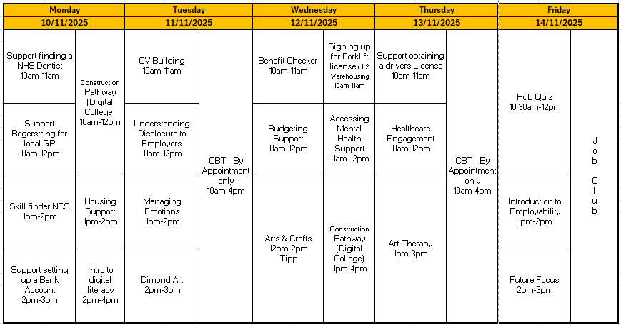







Self: Activities that work on the individual
NOVEMBER - WEEK 2
Relationships: Activities that work with peers/families/friends
Society: Activities contributing to the community outside of the CFO Activity Hub
Information
Address: - Urban Exchange, Theatre Street/Mount Street, Preston, PR1 8BQ
Contact: 07850 955413 (Amy)
Enrolments are needed to do any of the activities.
Our group activities include this week include; Arts & Crafts, Budgeting support, Art Therapy, Hub Games and Job Club.
All other Activities will be 1:1 with support worker.
UK Anti-Bullying Week: November 10th ODD SOCKS DAY - Participants wear mismatched socks to promote acceptance of differences and to kick off conversations about kindness, inclusion, and standing up against bullying
Tuesday 11th: Remembrance day
CBT- 2 days a week each day with 5 available slots
This programme is delivered by HMPPS CFO
V1.0

Slide 3
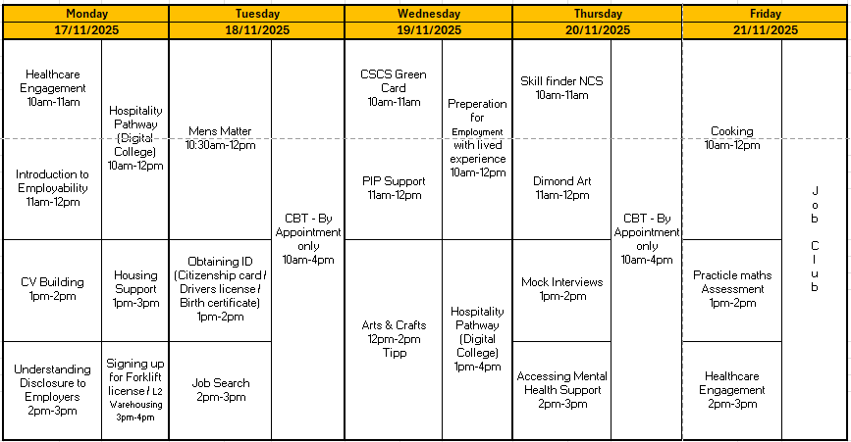

Self: Activities that work on the individual
NOVEMBER - WEEK 3
Relationships: Activities that work with peers/families/friends
Society: Activities contributing to the community outside of the CFO Activity Hub
Information
Address: - Urban Exchange, Theatre Street/Mount Street, Preston, PR1 8BQ
Contact: 07850 955413 (Amy)
Enrolments are needed to do any of the activities.
Our group activities include this week include; Men’s Matter, Arts & Crafts, Dimon Art, Mock Interviews, Cooking and Job Club.
All other Activities will be 1:1 with support worker.
CBT- 2 days a week each day with 5 available slots
This programme is delivered by HMPPS CFO
V1.0

Slide 4
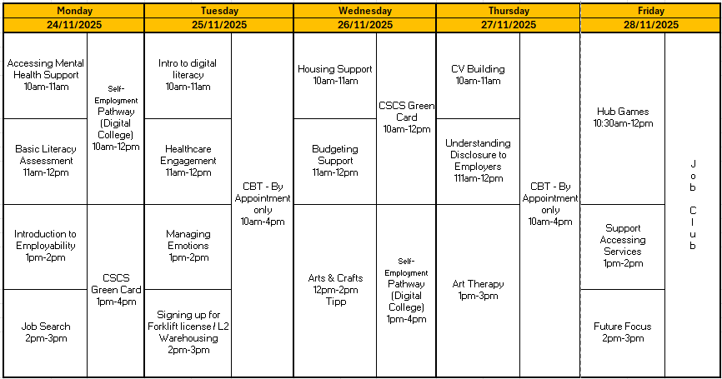



Self: Activities that work on the individual
NOVEMBER – WEEK 4
Relationships: Activities that work with peers/families/friends
Society: Activities contributing to the community outside of the CFO Activity Hub
Information
Address: - Urban Exchange, Theatre Street/Mount Street, Preston, PR1 8BQ
Contact: 07850 955413 (Amy)
Enrolments are needed to do any of the activities.
Our group activities include this week include; Arts & Crafts, Budgeting support, Art Therapy, Hub Games and Job Club.
All other Activities will be 1:1 with support worker.
CBT- 2 days a week each day with 5 available slots
This programme is delivered by HMPPS CFO
V1.0

