Slide 1
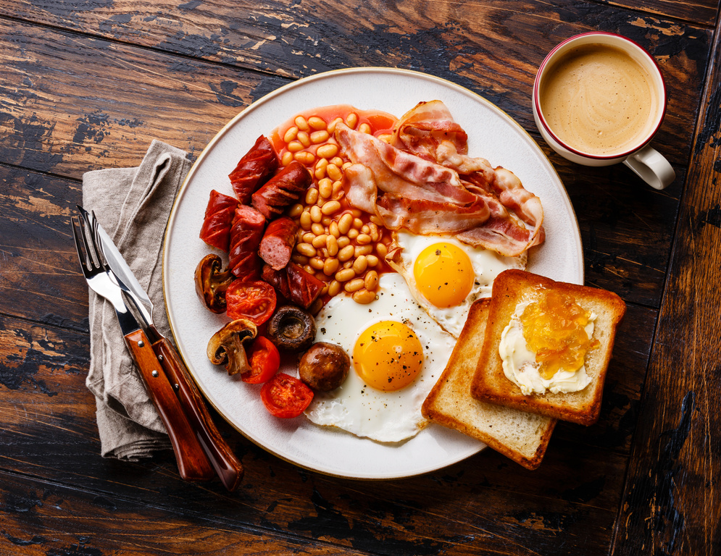
Self: Activities that work on the individual
CFO Evolution – June WK1
Relationships: Activities that work with peers/families/friends
Monday 2nd | Tuesday 3rd | Wednesday 4th | Thursday 5th | Friday 6th
Life Skills Improve your IT skills to help navigate you through daily life and improve your communication and problem-solving skills to help find employment. 9.30am –1pm | All Women’s Tuesday Wellbeing walk Benefit from physical activity in a walking group and Buying food on a budget 10am – 12pm | Baking morning Learn to bake and decorate cakes 10am – 1pm (level 1 / level 2 food hygiene course) Wellbeing walk Benefit from physical activity in a walking group 12pm – 1.pm | Independent Living Cooking on a budget (level 1 / level 2 food hygiene course) 1pm – 3pm | Wellbeing walk Benefit from physical activity in a walking group and Buying food on a budget 10am – 12pm
Start and introduction to Employability employment – (CV`s, disclosures, job search, national careers service) 1:30pm – 4pm | All Women’s Tuesday Cooking on a budget (level 1 / level 2 food hygiene course) 1pm – 3pm | Arts and Crafts Develop your practical Skills 2pm – 4pm | Music and Dance Music Blox with Rich Songform Lyrics Garageband 1.30pm | Wellbeing and mindfulness have a healthy and positive mental outlook & the importance of positive thoughts, feelings and behaviours in a session focused on men’s mental health
Society: Activities contributing to the community outside of the CFO Activity Hub
Hull Activity Hub
*If you ever need a cuppa or a chat, pop in and speak to your support worker.
*Drop in Session available for
1-2-1 Support. Please contact your support worker.
Reception contact number: 07502299992
9:30am -4pm
Monday – Friday
CFO Activity Hub, 55 Savillle street, Norwich house, hull, HU1 3EA
This programme is delivered by HMPPS CFO

Slide 2
Self: Activities that work on the individual
CFO Evolution – June WK2
Relationships: Activities that work with peers/families/friends
Monday 9th | Tuesday 10th | Wednesday 11th | Thursday 12th | Friday 13th
Life Skills Improve your IT skills to help navigate you through daily life and improve your communication and problem-solving skills to help find employment. 9.30am –1pm | All Women’s Tuesday Wellbeing walk Benefit from physical activity in a walking group and Buying food on a budget 10am – 12pm CBT Support your personal needs 10am – 4pm | Baking morning Learn to bake on a budget (level 1 / level 2 food hygiene course) 10am – 1pm Wellbeing walk Benefit from physical activity in a walking group 12pm – 1.pm | Independent Living Cooking on a budget (level 1 / level 2 food hygiene course) 1pm – 3pm | Wellbeing walk Benefit from physical activity in a walking group and Buying food on a budget 10am – 12pm
Start and introduction to Employability employment – (CV`s, disclosures, job search, national careers service) 1:30pm – 4pm | All Women’s Tuesday Cooking on a budget (level 1 / level 2 food hygiene course) 1pm – 3pm | Arts and Crafts Develop your practical Skills 2pm – 4pm | Music and Dance Music Blox with Rich Songform Lyrics Garageband 1.30pm. | Wellbeing and mindfulness Do you struggle with mental health issues? Do you need support? Learn how to develop a Healthy & positive mental outlook.
Society: Activities contributing to the community outside of the CFO Activity Hub
Hull Activity Hub
*If you ever need a cuppa or a chat, pop in and speak to your support worker.
*Drop in Session available for
1-2-1 Support. Please contact your support worker.
Reception contact number: 07502299992
9:30am -4pm
Monday – Friday
CFO Activity Hub, 55 Savillle street, Norwich house, hull, HU1 3EA
This programme is delivered by HMPPS CFO

Slide 3
Self: Activities that work on the individual
CFO Evolution – June WK3
Relationships: Activities that work with peers/families/friends
Monday 16th | Tuesday 17th | Wednesday 18th | Thursday 19th | Friday 20th
Life Skills Improve your IT skills to help navigate you through daily life and improve your communication and problem-solving skills to help find employment. 9.30am –1pm | All Women’s Tuesday Wellbeing walk Benefit from physical activity in a walking group and Buying food on a budget 10am – 12pm | Baking morning Learn to bake and decorate cakes 10am – 1pm (level 1 / level 2 food hygiene course) Wellbeing walk Benefit from physical activity in a walking group 12pm – 1.pm | Independent Living Cooking on a budget (level 1 / level 2 food hygiene course) 1pm – 3pm | Wellbeing Walk Benefit from physical activity in a walking group and Buying food on a budget 10am – 12pm
Start and introduction to Employability employment – (CV`s, disclosures, job search, national careers service) 1:30pm – 4pm | All Women’s Tuesday Cooking on a budget (level 1 / level 2 food hygiene course) 1pm – 3pm | Arts and Crafts Develop your practical Skills 2pm – 4pm | Music and Dance Music Blox with Rich Songform Lyrics Garageband 1.30pm | Wellbeing and mindfulness have a healthy and positive mental outlook & the importance of positive thoughts, feelings and behaviours in a session focused on men’s mental health
Society: Activities contributing to the community outside of the CFO Activity Hub
Hull Activity Hub
*If you ever need a cuppa or a chat, pop in and speak to your support worker.
*Drop in Session available for
1-2-1 Support. Please contact your support worker.
Reception contact number: 07502299992
9:30am -4pm
Monday – Friday
CFO Activity Hub, 55 Savillle street, Norwich house, hull, HU1 3EA
This programme is delivered by HMPPS CFO

Slide 4
Self: Activities that work on the individual
CFO Evolution – June WK4
Relationships: Activities that work with peers/families/friends
Monday 23rd | Tuesday 24th | Wednesday 25th | Thursday 26th | Friday 27th
Life Skills Improve your IT skills to help navigate you through daily life and improve your communication and problem-solving skills to help find employment. 9.30am –1pm | All Women’s Tuesday Wellbeing walk Benefit from physical activity in a walking group and Buying food on a budget 10am – 12pm CBT Support your personal needs 10am – 4pm | Baking morning Learn to bake and decorate cakes 10am – 1pm (level 1 / level 2 food hygiene course) Wellbeing walk Benefit from physical activity in a walking group 12pm – 1.pm | Independent Living Cooking on a budget (level 1 / level 2 food hygiene course) 1pm – 3pm | Wellbeing walk Benefit from physical activity in a walking group and Buying food on a budget 10am – 12pm
Start and introduction to Employability employment – (CV`s, disclosures, job search, national careers service) 1:30pm – 4pm | All Women’s Tuesday Cooking on a budget (level 1 / level 2 food hygiene course) 1pm – 3pm | Arts and Crafts Develop your practical Skills 2pm – 4pm | Music and Dance Music Blox with Rich Songform Lyrics Garageband 1.30pm | Wellbeing and mindfulness have a healthy and positive mental outlook & the importance of positive thoughts, feelings and behaviours in a session focused on men’s mental health
Society: Activities contributing to the community outside of the CFO Activity Hub
Hull Activity Hub
*If you ever need a cuppa or a chat, pop in and speak to your support worker.
*Drop in Session available for
1-2-1 Support. Please contact your support worker.
Reception contact number: 07502299992
9:30am -4pm
Monday – Friday
CFO Activity Hub, 55 Savillle street, Norwich house, hull, HU1 3EA
This programme is delivered by HMPPS CFO

