Slide 1


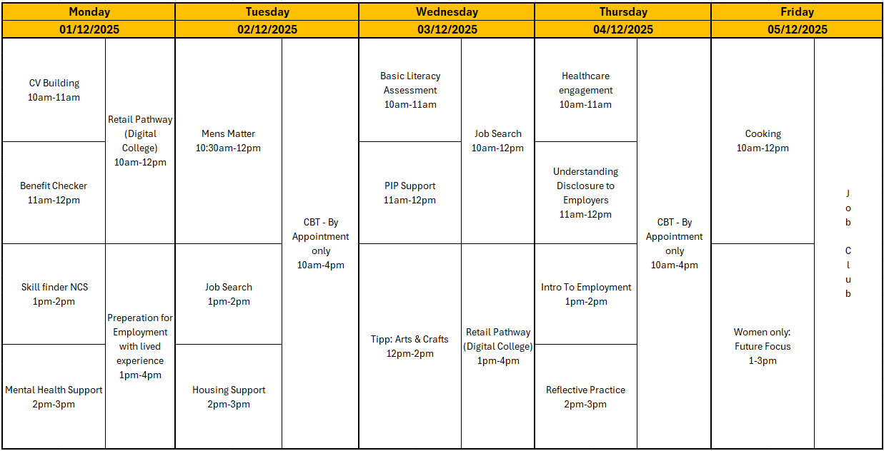

















Self: Activities that work on the individual
DECEMBER - WEEK 1
Relationships: Activities that work with peers/families/friends
Society: Activities contributing to the community outside of the CFO Activity Hub
Information
Address: - Urban Exchange, Theatre Street/Mount Street, Preston, PR1 8BQ
Contact: 07850 955413 (Amy)
Enrolments are needed to do any of the activities.
Our group activities include this week include; Men’s Matter, Arts & Crafts, Mock Interviews and preparing for employment, Cooking and Job Club. This week’s women’s only session will be Friday afternoon Future focus.
All other Activities will be 1:1 with support worker.
CBT- 2 days a week each day with 5 available slots
This programme is delivered by HMPPS CFO
V1.0

Slide 2
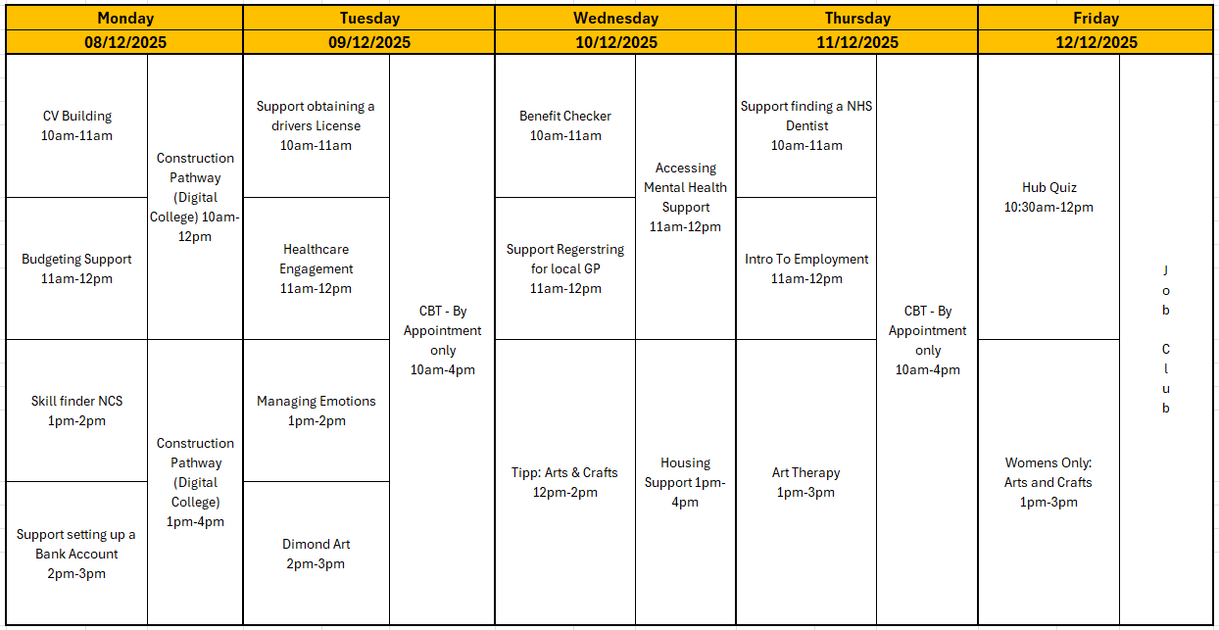








Self: Activities that work on the individual
DECEMBER - WEEK 2
Relationships: Activities that work with peers/families/friends
Society: Activities contributing to the community outside of the CFO Activity Hub
Information
Address: - Urban Exchange, Theatre Street/Mount Street, Preston, PR1 8BQ
Contact: 07850 955413 (Amy)
Enrolments are needed to do any of the activities.
Our group activities include this week include; Arts & Crafts, Managing emotions, Diamond Art, Art Therapy, Hub Games and Job Club. A well as women’s only afternoon on Friday where we will be running an arts and crafts intro session.
All other Activities will be 1:1 with support worker.
CBT- 2 days a week each day with 5 available slots
This programme is delivered by HMPPS CFO
V1.0

Slide 3
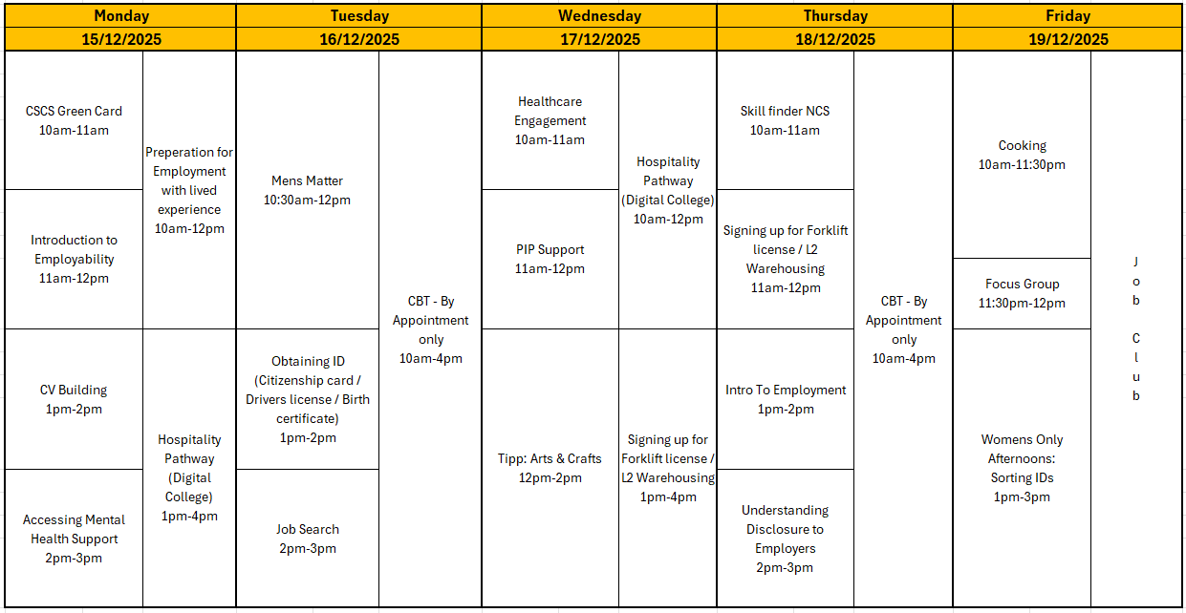
Self: Activities that work on the individual
DECEMBER - WEEK 3
Relationships: Activities that work with peers/families/friends
Society: Activities contributing to the community outside of the CFO Activity Hub
Information
Address: - Urban Exchange, Theatre Street/Mount Street, Preston, PR1 8BQ
Contact: 07850 955413 (Amy)
Enrolments are needed to do any of the activities.
Our group activities include this week include; Men’s Matter, Arts & Crafts, Dimon Art, Mock Interviews, Cooking and Job Club.
All other Activities will be 1:1 with support worker.
CBT- 2 days a week each day with 5 available slots
This programme is delivered by HMPPS CFO
V1.0

Slide 4
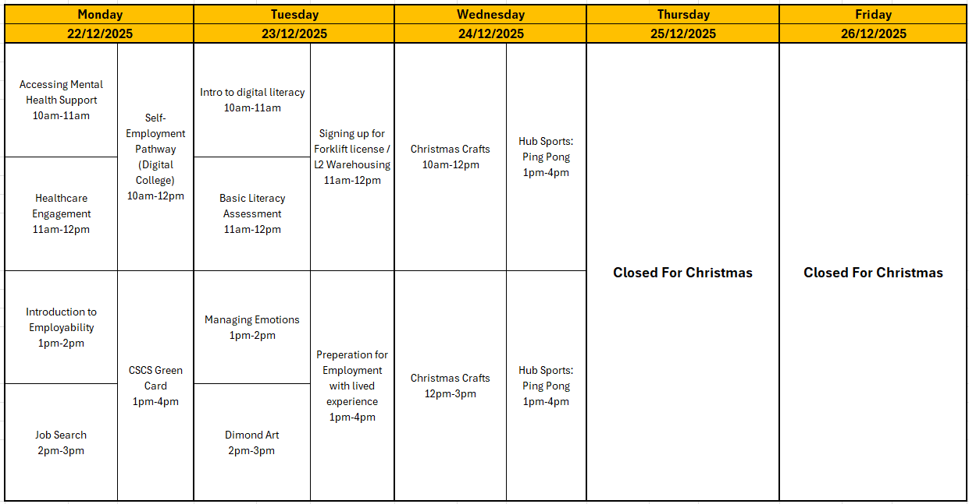




Self: Activities that work on the individual
DECEMBER – WEEK 4
Relationships: Activities that work with peers/families/friends
Society: Activities contributing to the community outside of the CFO Activity Hub
Information
Address: - Urban Exchange, Theatre Street/Mount Street, Preston, PR1 8BQ
Contact: 07850 955413 (Amy)
Enrolments are needed to do any of the activities.
Our group activities include this week include; Christmas Arts & Crafts, Ping Pong, Hub Games, managing emotions and diamond art.
All other Activities will be 1:1 with support worker.
The Hub Will be closed over the holidays starting 25/12/2025 re-opening on 02/01/2026
This programme is delivered by HMPPS CFO
V1.0

Slide 5
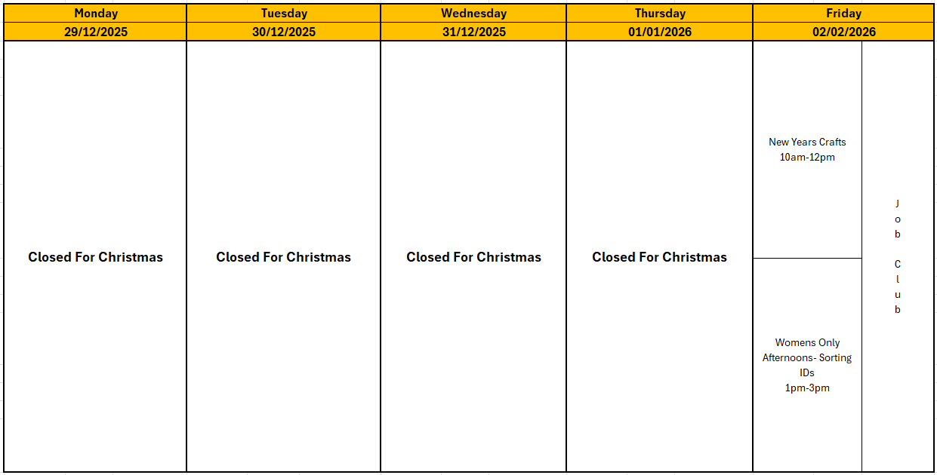
Self: Activities that work on the individual
DECEMBER – WEEK 4
Relationships: Activities that work with peers/families/friends
Society: Activities contributing to the community outside of the CFO Activity Hub
Information
Address: - Urban Exchange, Theatre Street/Mount Street, Preston, PR1 8BQ
Contact: 07850 955413 (Amy)
Enrolments are needed to do any of the activities.
Our group activities include this week include; New years Arts & Crafts, and Job Club.
All other Activities will be 1:1 with support worker.
The Hub Will be closed over the holidays starting 25/12/2025 re-opening on 02/01/2026
This programme is delivered by HMPPS CFO
V1.0

