Slide 1
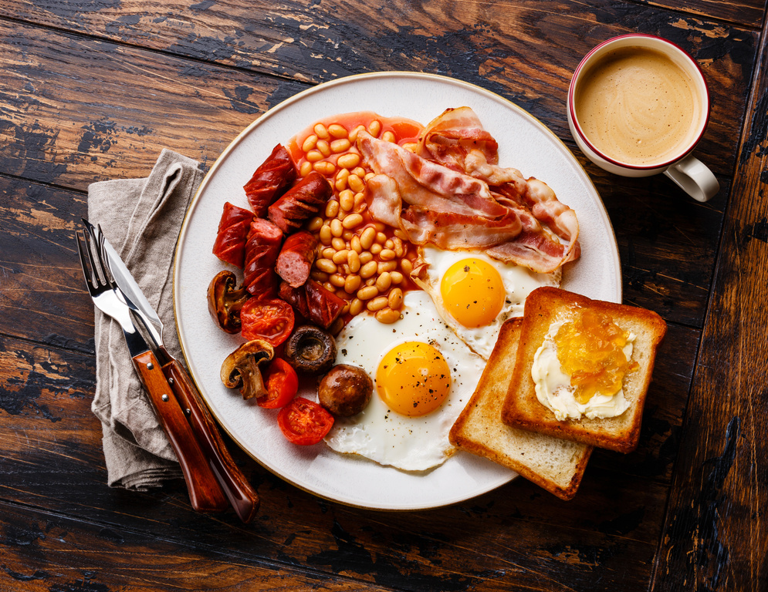
Self: Activities that work on the individual
CFO Evolution - December
Relationships: Activities that work with peers/families/friends
Monday 2nd | Tuesday 3rd | Wednesday 4th | Thursday 5th | Friday 6th
Cooking on a budget 10am – 12pm | Coping with stress/ change 10am – 11am | Education & Employment Day! Come along and meet training providers offering specialist support in: Construction-Warehouse-Retail-Hospitality-Hair & Beauty training providers Employment support-interview-disclosure-CV writing | Drop-in session (accommodation budgeting, wellbeing etc.) 10am – 12pm | Specialist support Day! Support services here to support with your concerns in Debt advice Mental health support Substance misuse support
Drop-in session (accommodation budgeting, wellbeing ETE etc.) 10am – 12pm | Future Focus 11am – 12pm |  | Exercise 11am – 12pm
 |  |  | Women’s only afternoon (wellbeing, cooking and confidence building) 1pm – 3pm | Attitudes and Lifestyles (budgeting, accommodation and goal setting) 11am – 12pm
Wellbeing and Mindfulness 1pm – 2pm | Man Plan (men’s mental health group) 1pm-2pm |  | Women’s only afternoon (wellbeing, cooking and confidence building) 1pm – 3pm | Attitudes and Lifestyles (budgeting, accommodation and goal setting) 11am – 12pm
Spectrum (LGBTQIA+) 2pm – 3pm | Relationships 2pm – 3pm | Crafting through the Snow 1pm – 3pm
Spectrum (LGBTQIA+) 2pm – 3pm | Relationships 2pm – 3pm | Arts and Crafts Workshop 1pm – 3pm |  | Fun Fridays (social afternoon, games, quiz’ and wellbeing activities) 1pm – 3pm
Society: Activities contributing to the community outside of the CFO Activity Hub
Doncaster Activity Hub
Unit 25/27 7 Queens Crescent Doncaster DN1 3JN
If you ever need a cuppa or a chat, pop in and speak to your support worker.
Reception contact number: 07502299992
9:30am – 16:00pm
Monday – Friday
This programme is delivered by HMPPS CFO

Slide 2
Self: Activities that work on the individual
CFO Evolution - December
Relationships: Activities that work with peers/families/friends
Monday 9th | Tuesday 10th | Wednesday 11th | Thursday 12th | Friday 13th
Cooking on a budget 10am – 12pm | Coping with stress/ change 10am – 11am | Education & Employment Day! Come along and meet training providers offering specialist support in: Construction-Warehouse-Retail-Hospitality-Hair & Beauty training providers Employment support-interview-disclosure-CV writing | Drop-in session (accommodation budgeting, wellbeing etc.) 10am – 12pm | Specialist support Day! Support services here to support with your concerns in Debt advice Mental health support Substance misuse support
Drop-in session (accommodation budgeting, wellbeing etc.) 10am – 12pm | Future Focus 11am – 12pm |  | Exercise 11am – 12pm
 |  |  | Women’s only afternoon (wellbeing, cooking and confidence building) 1pm – 3pm | Attitudes and Lifestyles (budgeting, accommodation and goal setting) 11am – 12pm
Wellbeing and Mindfulness 1pm – 2pm | Man Plan (men’s mental health group) 1pm-2pm |  | Women’s only afternoon (wellbeing, cooking and confidence building) 1pm – 3pm | Attitudes and Lifestyles (budgeting, accommodation and goal setting) 11am – 12pm
Spectrum (LGBTQIA+) 2pm – 3pm | Relationships 2pm – 3pm | Crafting through the Snow 1pm – 3pm
Spectrum (LGBTQIA+) 2pm – 3pm | Relationships 2pm – 3pm | Arts and Crafts Workshop 1pm – 3pm |  | Fun Fridays (social afternoon, games, quiz’ and wellbeing activities) 1pm – 3pm
Society: Activities contributing to the community outside of the CFO Activity Hub
Doncaster Activity Hub
Unit 25/27 7 Queens Crescent Doncaster DN1 3JN
If you ever need a cuppa or a chat, pop in and speak to your support worker.
Reception contact number: 07502299992
9:30am – 16:00pm
Monday – Friday
This programme is delivered by HMPPS CFO

Slide 3
Self: Activities that work on the individual
CFO Evolution - December
Relationships: Activities that work with peers/families/friends
Monday 16th | Tuesday 17th | Wednesday 18th | Thursday 19th | Friday 20th
Cooking on a budget 10am – 12pm | Christmas celebrations Christmas Dinner Christmas Quiz and games | Education & Employment Day! Come along and meet training providers offering specialist support in: Construction-Warehouse-Retail-Hospitality-Hair & Beauty training providers Employment support-interview-disclosure-CV writing | Coping with stress/ change 10am – 11am | Specialist support Day! Support services here to support with your concerns in Debt advice Mental health support Substance misuse support
Hub Club You said, We did. Have your say on the changes you would like to see! 10:30-11:30 |  |  | Future Focus 11am – 12pm
 |  |  |  | Hub closed from 2pm
Wellbeing and Mindfulness 1pm – 2pm |  |  |  | Attitudes and Lifestyles (budgeting, accommodation and goal setting) 11am – 12pm
Spectrum (LGBTQIA+) 2pm – 3pm |  | Crafting through the snow 1pm – 3pm | Relationships 2pm – 3pm
Society: Activities contributing to the community outside of the CFO Activity Hub
Doncaster Activity Hub
Unit 25/27 7 Queens Crescent Doncaster DN1 3JN
If you ever need a cuppa or a chat, pop in and speak to your support worker.
Reception contact number: 07502299992
9:30am – 16:00pm
Monday – Friday
This programme is delivered by HMPPS CFO

Slide 4
Self: Activities that work on the individual
CFO Evolution – December
Relationships: Activities that work with peers/families/friends
Monday 23rd | Tuesday 24th | Wednesday 25th (Hub closed) | Thursday 26th (Hub closed) | Friday 27th (Hub closed)
Cooking on a budget 10am – 12pm | Social morning Wellbeing check ins prior to the Christmas Period Games and snacks! 10am – 12pm | Have a lovely Christmas and a Happy New Year. Please note the CFO Activity Hubs will be back open on the 2nd January 2025. For any support over the Christmas period, please see below contact numbers: Samaritans 116 123 CALM 0800 58 58 58 MoneyHelper 0800 138 7777 National Domestic Abuse Helpline 0808 2000 247 NHS 111 Emergency helpline 999
Drop-in session (accommodation budgeting, wellbeing etc.) 10am – 12pm
Wellbeing and Mindfulness 1pm – 2pm | Hub shut from 1pm.
Spectrum (LGBTQIA+) 2pm – 3pm
Society: Activities contributing to the community outside of the CFO Activity Hub
Doncaster Activity Hub
Unit 25/27 7 Queens Crescent Doncaster DN1 3JN
If you ever need a cuppa or a chat, pop in and speak to your support worker.
Reception contact number: 07502299992
9:30am – 16:00pm
Monday – Friday
This programme is delivered by HMPPS CFO

