Slide 1










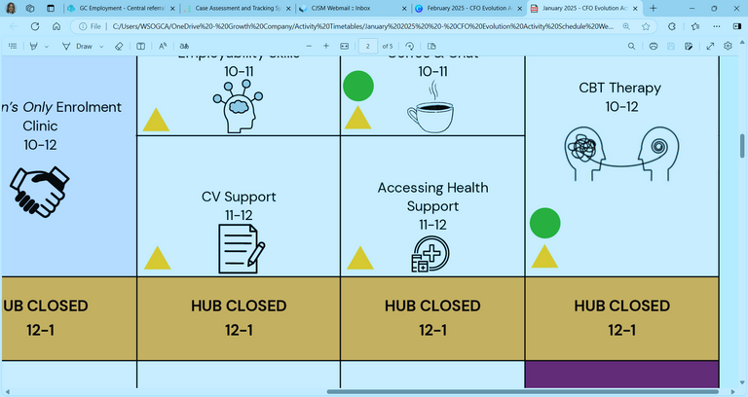



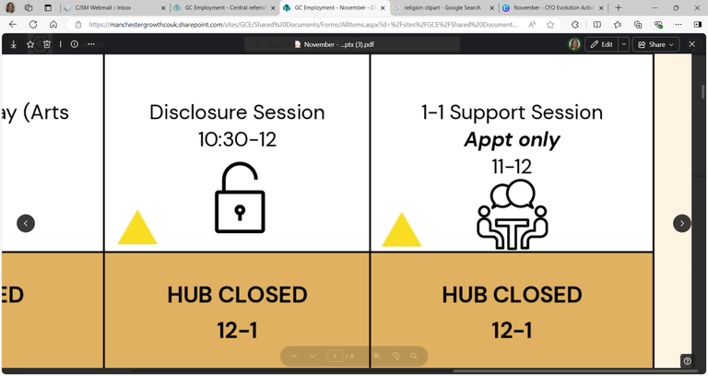












Self: Activities that work on the individual
OCTOBER - WEEK 1
Relationships: Activities that work with peers/families/friends
Society: Activities contributing to the community outside of the CFO Activity Hub
Monday 29th | Tuesday 30th |  | Wednesday 1st | Thursday 2nd | Friday 3rd
 |  |  | Job Club 9:30 - 12 | Hub Canal Walk 9:30 - 12 | Enrolment Clinic 9:30 - 11
 |  |  |  |  | Disclosure 11 - 12
HUB CLOSED 12-1 | HUB CLOSED 12-1 |  | HUB CLOSED 12-1 | HUB CLOSED 12-1 | HUB CLOSED 12-1
Self Care 1 - 2 |  |  |  | Women’s Only Sentence Requirement Support 1 – 2:30 | Housing Advice & Support 1 – 2:30
 |  |  | Wellbeing Goal Setting 3 - 4 | Women’s Only Benefit Support 2:30 - 4 | Therapeutic Art 2:30 - 4
Where to Start and an Introduction to Employability
9:30 - 12
Sentence Requirement Support
9:30 – 10:30
CBT
Appt only
10 - 12
Digital College
10:30 - 12
Debt Management & Budgeting
1 – 3
TiPP
Art Session
1 - 3
CBT Therapy
Appt only
1 - 4
TiPP
Drama
Music
2 - 4
ETE Awards & Quiz
3 - 4
This programme is delivered by HMPPS CFO

Slide 2

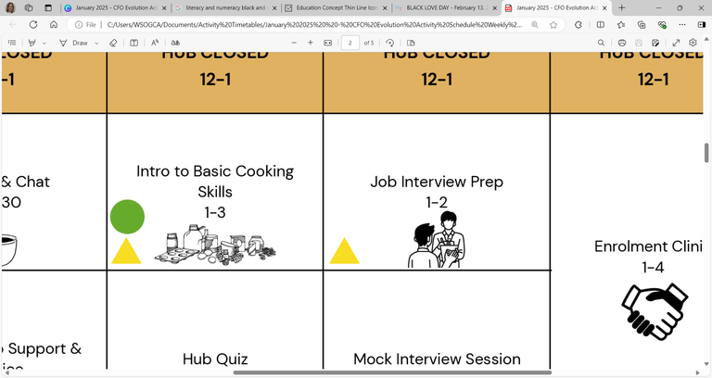







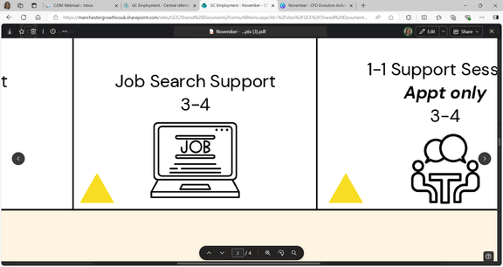








Self: Activities that work on the individual
OCTOBER - WEEK 2
Relationships: Activities that work with peers/families/friends
Society: Activities contributing to the community outside of the CFO Activity Hub
Monday 6th |  | Tuesday 7th |  | Wednesday 8th | Thursday 9th | Friday 10th
 |  |  |  | Women’s Only Accessing a Bank Account 9:30 – 10:30
 |  |  |  | Women’s Only Future Focus 10:30 - 12
HUB CLOSED 12-1 |  | HUB CLOSED 12-1 |  | HUB CLOSED 12-1 | HUB CLOSED 12-1 | HUB CLOSED 12-1
 |  |  |  |  | Relationship Advice & Support 1 – 2:30 | World Mental Health Day 1 - 3
 |  |  |  | Accessing Health Support 3 - 4 | Numeracy & Literacy Skills 2:30 – 4 | Emotional Resilience 3 - 4
Address:
First Floor Offices, Crabtree Street, Furthergate Industrial Estate, Blackburn, BB1 3BD
Contact Information:
07775 096192 (Gabriella)
07384 119231 (Nadya)
07712 511792 (Aisha)
Enrolments are needed to do any of the activities.
Our 1:1 activities include; Housing, Employment, Training, Money Management, Healthcare and Enrolment, or you can book specific 1-1 support session with your support worker.
They are appointment only!
We offer group sessions such as Hub Walks around Corporation Park, Coffee & Chat Sessions, a Hub Quiz, various Arts and Craft sessions, and Cooking Sessions. Employment activities included Interview Prep, Completing Application Forms or just simply support with Job Searching/Training.
CV
Support
9:30 - 11
Interview Preparation
9:30 – 11
In Work Support
9:30 - 11
1-1 Support Sessions
Appt only
9:30 - 12
Enrolment Clinic
9:30 - 12
CBT
Appt only
10 - 12
Digital College
9:30 - 12
Industry Specific Cards
11 - 12
Job Application Support
11- 12
Job & Course Searching
11 - 12
Confidence Building
1 - 2
Mindfulness Techniques
1 - 2
TiPP
Art Session
1 - 3
CBT Therapy
Appt only
1 - 4
TiPP
Drama
Music
2 - 4
National Taco Day
Cooking Session
2 - 4
This programme is delivered by HMPPS CFO

Slide 3

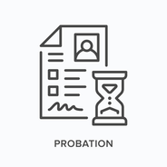





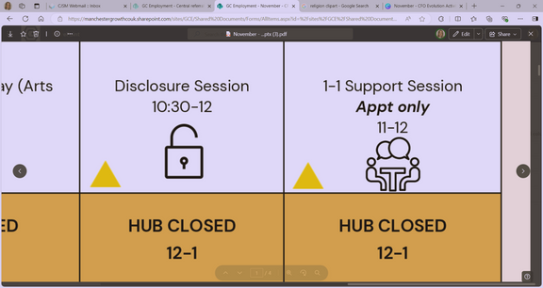
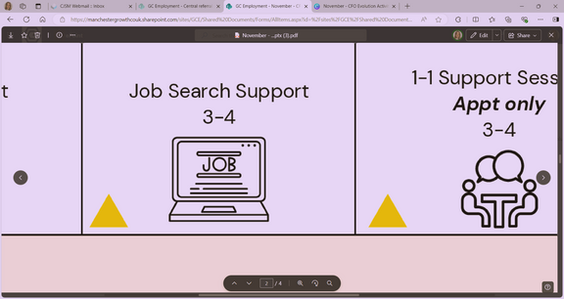

Self: Activities that work on the individual
OCTOBER - WEEK 3
Relationships: Activities that work with peers/families/friends
Society: Activities contributing to the community outside of the CFO Activity Hub
Monday 13th | Tuesday 14th |  | Wednesday 15th | Thursday 16th |  |  | Friday 17th
Mock Interviews 9:30- 11 |  |  |  |  |  |  | Employability Skills 9:30 - 11
Job Application Support 11 - 12
HUB CLOSED 12-1 | HUB CLOSED 12-1 |  | HUB CLOSED 12-1 | HUB CLOSED 12-1 |  |  | HUB CLOSED 12-1
Problem Solving Techniques 1 - 2 |  |  |  | Benefit Support 1 – 2:30 |  |  | Therapeutic Art 1 – 2:30
 |  |  | Budgeting Session 3 - 4 | World Food Day Healthy Living Techniques Session 2:30 - 4 |  |  | Housing Advice & Support 2:30 – 4
Unpaid Work Support
9:30 -11
Disclosure
9:30 – 11
Intro to Customer Service
9:30 - 12
Enrolment Clinic
9:30 - 12
CBT
Appt only
10 - 12
Job Search
11 - 12
Cover Letter Support
11 - 12
Obtaining National Insurance
11 - 12
Women’s Only
Disclosure
1 – 2:30
TiPP
Art Session
1 - 3
CBT Therapy
Appt only
2 - 4
TiPP
Drama
Music
2 - 4
Women’s Only
Job & Course Search
2:30 - 4
This programme is delivered by HMPPS CFO

Slide 4


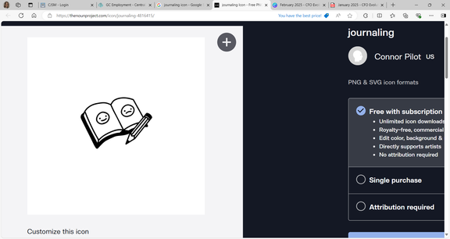






Self: Activities that work on the individual
OCTOBER - WEEK 4
Relationships: Activities that work with peers/families/friends
Society: Activities contributing to the community outside of the CFO Activity Hub
Monday 20th | Tuesday 21st |  | Wednesday 22nd | Thursday 23rd |  | Friday 24th
CV Support 9:30 - 11 |  |  | Women’s Only Self Care 9:30 – 10:30 |  |  | Future Focus 9:30 - 11
In Work Support 11 - 12 |  |  | Women’s Only Digital College 10:30 - 12 |  |  | Right to Work Support 11 - 12
HUB CLOSED 12-1 | HUB CLOSED 12-1 |  | HUB CLOSED 12-1 | HUB CLOSED 12-1 |  | HUB CLOSED 12-1
Motivation 1 - 2 |  |  | TiPP Art Session 1 - 3 | Optimism & Self-Worth 1 - 2:30 |  | Feelings of Hope & Self-Efficacy 1 - 3
 |  |  | Accessing Mainstream Services 3 - 4 | Victim Awareness 2:30 - 4 |  | Ping Pong 3 - 4
Enrolment Clinic
9:30 - 12
CBT
Appt only
10 - 12
Intro to Customer Service
9:30 - 12
Personal Journalling
1 – 2:30
CBT
Appt only
1 - 4
National Day of the Nacho
Cooking Session
2:30 - 4
TiPP
Drama
Music
2 - 4
This programme is delivered by HMPPS CFO

Slide 5









Self: Activities that work on the individual
OCTOBER - WEEK 5
Relationships: Activities that work with peers/families/friends
Society: Activities contributing to the community outside of the CFO Activity Hub
Monday 27th | Tuesday 28th |  | Wednesday 29th | Thursday 30th |  | Friday 31st
Women’s Only CV Support 9:30 – 11 |  |  | Future Focus 9:30 - 11
Women’s Only Motivation Session 11 - 12 |  |  | Job Search 11 - 12
HUB CLOSED 12-1 | HUB CLOSED 12-1 |  | HUB CLOSED 12-1 | HUB CLOSED 12-1 |  | HUB CLOSED 12-1
 |  |  |  | Relationship Advice & Support 1 – 2:30 |  | Reflective Practice 1 - 2
 |  |  | Anger Management 3 - 4 | Debt Management & Budgeting 2:30 - 4 |  | Halloween Arts, Crafts & Quiz 2 – 4
Address:
First Floor Offices, Crabtree Street, Furthergate Industrial Estate, Blackburn, BB1 3BD
Contact Information:
07775 096192 (Gabriella)
07384 119231 (Nadya)
07712 511792 (Aisha)
Enrolments are needed to do any of the activities.
Our 1:1 activities include; Housing, Employment, Training, Money Management, Healthcare and Enrolment, or you can book specific 1-1 support session with your support worker.
They are appointment only!
We offer group sessions such as Hub Walks around Corporation Park, Coffee & Chat Sessions, a Hub Quiz, various Arts and Craft sessions, and Cooking Sessions. Employment activities included Interview Prep, Completing Application Forms or just simply support with Job Searching/Training.
1-1 Support Session
Appt only
9:30 - 11
Introduction to Self-Employment
9:30 - 12
Job Club
9:30 - 12
Enrolment Clinic
9:30 - 11
CBT
Appt only
10 - 12
Disclosure
11 - 12
Industry Specific Cards
11 - 12
National Mentoring Day
Celebrating the Hub Mentors’ Achievements
1 - 2
Addiction Support
1 – 2:30
TiPP
Art Session
1 - 3
CBT Therapy
Appt only
1 - 4
New & Pro-Social Identity
2:30 - 4
TiPP
Drama
Music
2 - 4
This programme is delivered by HMPPS CFO

